Slide 1



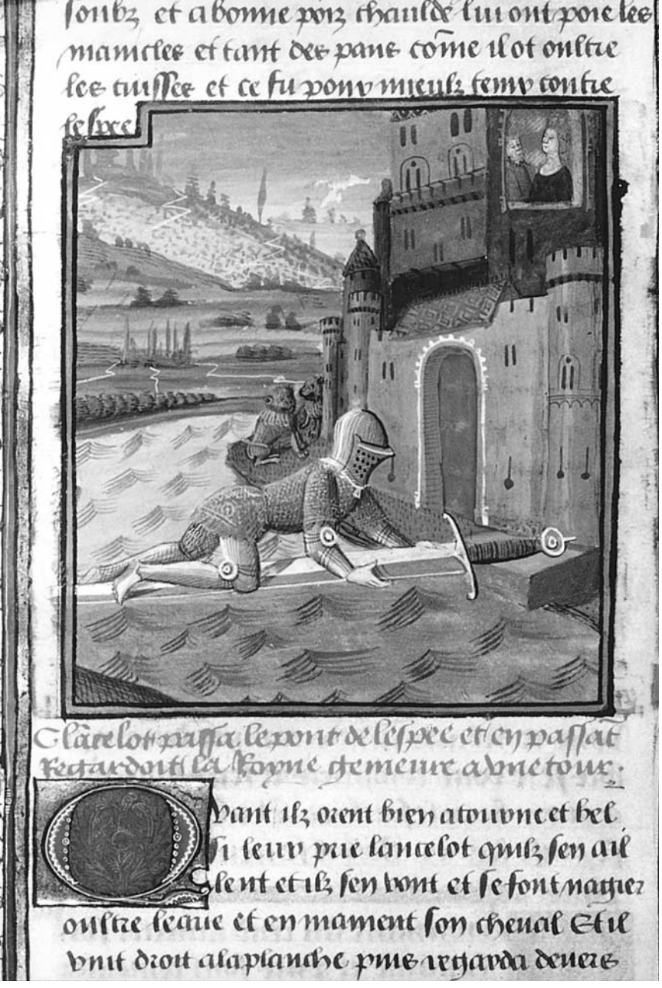

Romance Tradition in Medieval English Literature
Week -5
Assist. Prof. Dr. Pelin GÖLCÜK MİRZA

Slide 2
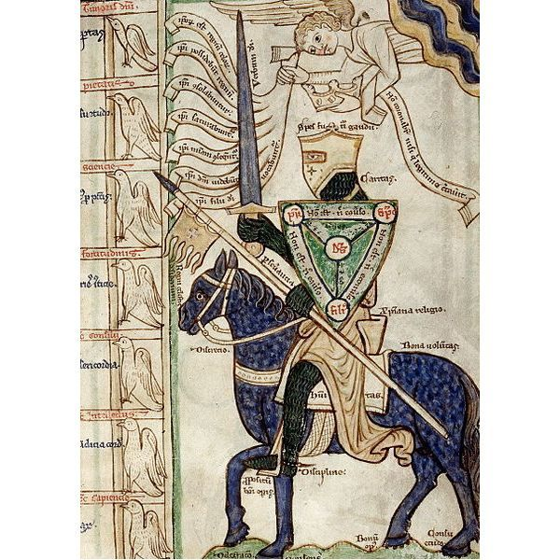
In The Cambridge Companion to Medieval Romance, Roberta Krueger identifies romance term as «the narratives of chivalric adventures and courtly love» (Krueger 1)
M. H. Abrahams also defines romance as «a narrative form which developed in twelfth-century France, spread to the literatures of other countries, and displaced the various epic and heroic forms of narrative» (25).

Slide 3
Historical Background
z
NORMAN CONQUEST (1066)
A new ruling class with a different language
Aristocratic literature (French taste)
Feudalism (Nobleman- Serf- Artisans/Merchants)
Ovid’s Ars Amatoria (love as a military service, strictest obedience to the woman)
Provincial/ Troubadour Poetry (Singing bards, travelling and praising the deeds of knights)

Slide 4
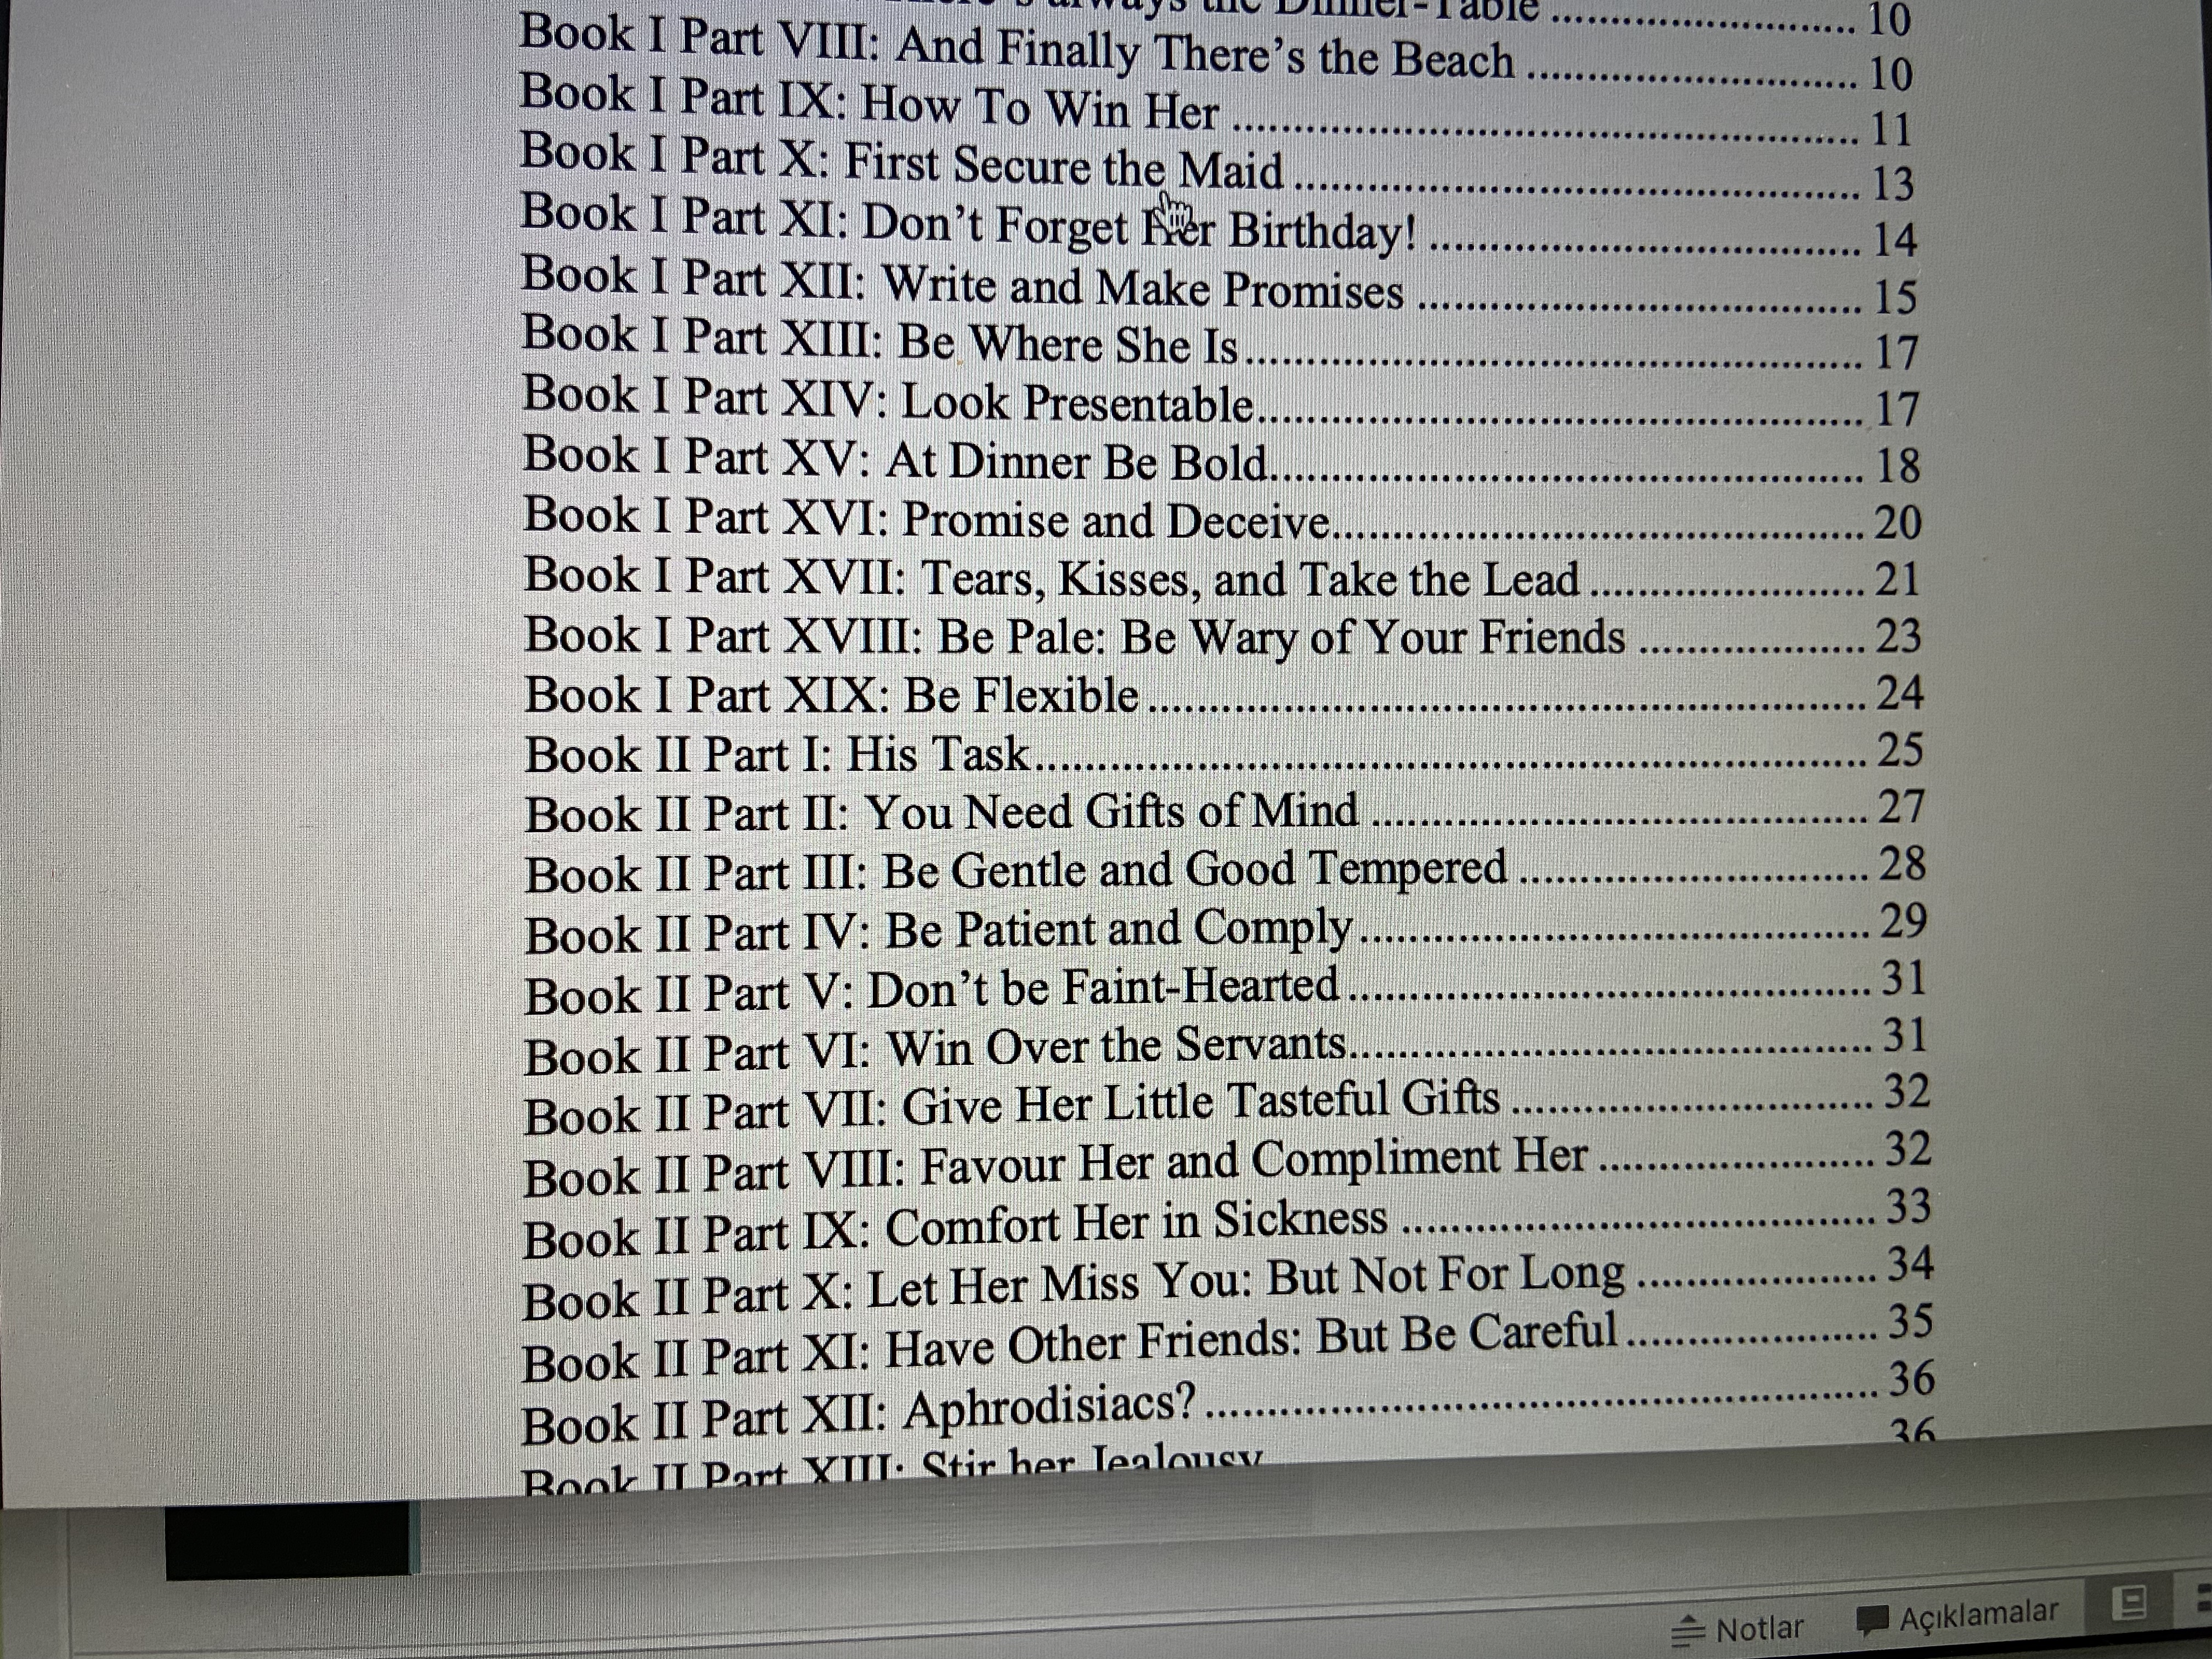
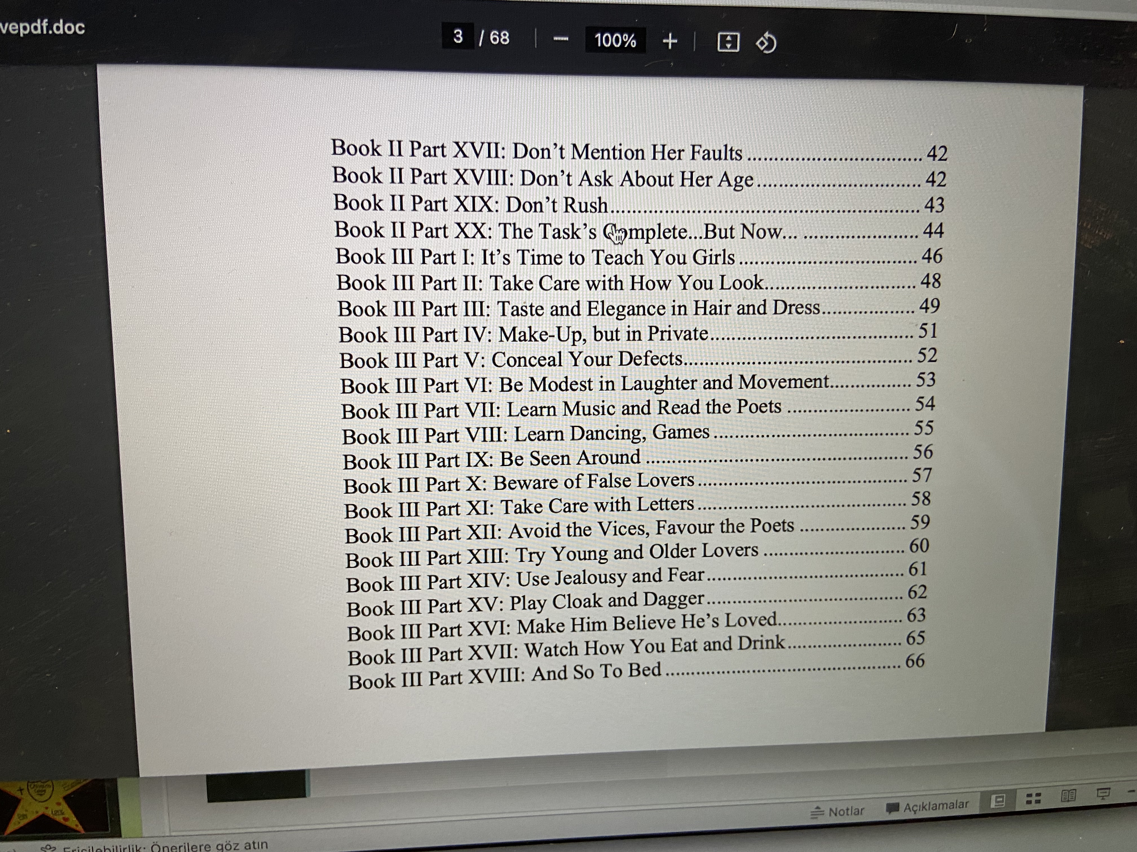
Ovid’s Ars Amatoria
z

Slide 5
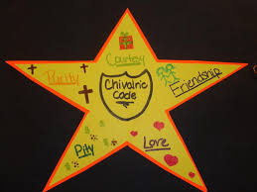
BASIC CHARACTERISTICS
z
1. Fictional narrative
2. Prose or verse
3. Chivalric age
4. Adventure
6. Entertainment
5.Supernatural elements

Slide 6
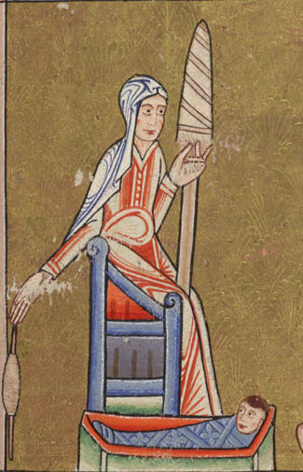
7- Courtly Love
Courtly love placed the lady on a pedestal
She was the epitome of splendor, beauty and goodness.
A knight should be chivalrous enough to love her, without crossing the boundaries into a sexual relation
z

Slide 7
Knighthood Ideals
z
1- Knight in a battlefield: (fight for nation)
2- Knight as a good Christian: (fight for God and expansion of Christianity)
3- Knight as a lover: (Fight for the queen)

Slide 8
Literary Characteristics
z
1. Stock characters
A Knight – An endangered lady- A monstrous challenger
2. Repeated Plot
Journey- supernatural elements- joyous return- celebration
3. Identifiable motifs
4. Conventional phrases (Chism 57)

Slide 9
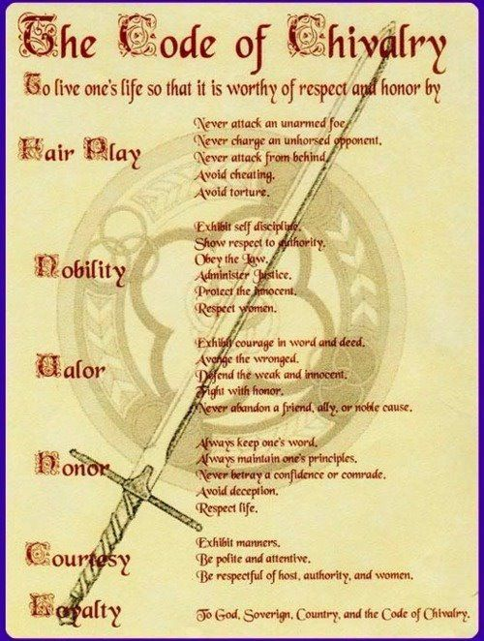

Slide 10
MATTERS OF ROMANCE TRADITION
Matter of France
Matter of Rome
Matter of England
Matter of Britain (Briton lai)
Jean Bodel
A. H. Abrahams

Slide 11
Examples
z
Sir Gawain and Green Knight
Morte D’Arthur
Sir Thopas
Sir Orfeo

Slide 12
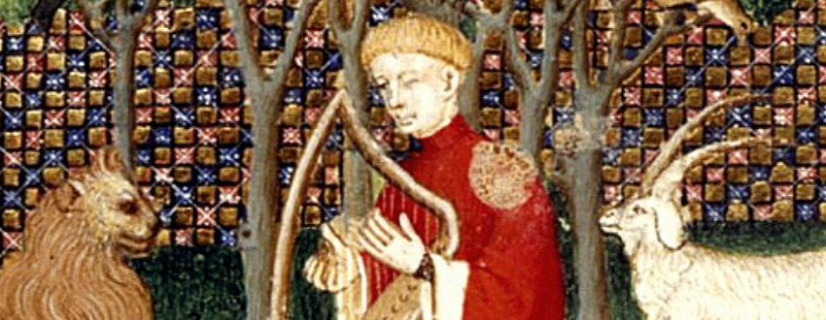
z
Sir Orfeo (1300)

Slide 13
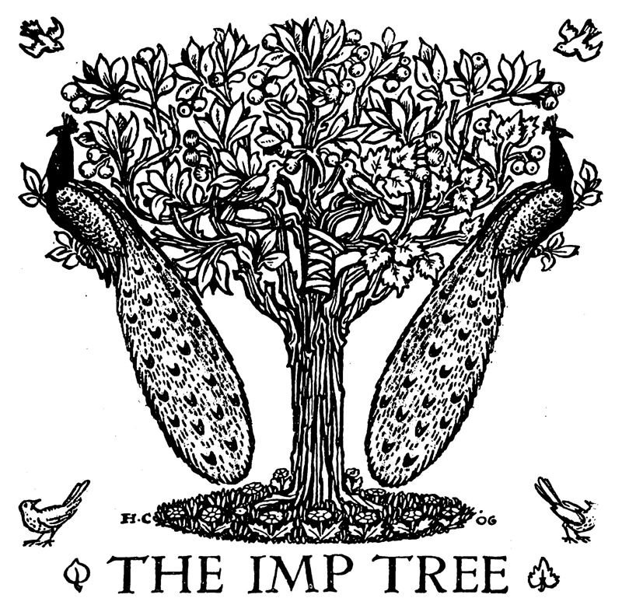
The King of Fairies
(Supernatural element)
Sir Orfeo (Nobleman)
Herodis (Endangered lady)
Sir Orfeo
Orfeo hadde a queene of pris
That was ycleped Dame Heurodis,
The fairest lady for the nones
That mighte goon on body and bones,
Ful of love and of goodnesse—
But no man may telle hir fairnesse (51-56)
Orfeo was a riche king,
In Engelond an heigh lording,
A stalworth man and hardy bo,
Large and curteis he was also. (25-29)
‘Looke tomorwe that thou be
Right here under this impe-tree,
And thanne thou shalt with us go,
And live with us everemo. (165-169)

Slide 14
z
Celtic Motifs
Christian Elements
Chivalric Codes
Joyous Return
Happy Ending

Slide 15
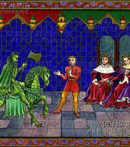
z
Sir Gawain and the Green Knight

Slide 16
The Gawain Poet:
Sir Gawain and the Green Knight was probably composed in the mid to late fourteenth century by an unknown author, often referred to as "The Gawain Poet." Although his identity remains unknown, the Gawain Poet’s rich imagination and skill have earned him recognition as one of the greatest medieval English poets.
It is one of best example of alliterative verses fostering the themes of loyalty and sacrifice.
It is told in the Arthurian tradition since legends of King Arthur and his Knights of the Round Table were very popular during the medieval period. The people enjoyed hearing heroic stories of gallant knights and their chivalrous deeds. The idealized legends of knights were a far cry from the reality of plagues, political battles and civil unrest in real medieval England.
​
Because of his dialect, the Gawain Poet probably lived in the northwestern part of England rather than London. His writing reflects a knowledge of aristocratic life as well as a love of rural life. The sole surviving manuscript is from about 1400 and contains three religious poems (Pearl, Purity, and Patience), which are also believed to be his works. The Gawain Poet is sometimes called the Pearl Poet.

Slide 17
The Code of Chivalry
The heroic ideals of the pagan culture were adjusted to the comparatively more civilized life style of the court and aristocracy in the middle ages.
Chivalry as a term derives from a french word chevalrie meaning a group of horsemen and their military skills.
Knighthood institutionalized: At age 7, boys from nobility became pages in the castles of nobles; at age 14, they became squires, serving knights and learning horsemanship and military skills; at age 21, they were knighted.
A knight owed loyalty to God, to his lord, and to a lady to whom he had sworn his platonic love. Knights often competed in tournaments to prove their prowess.
Real knights were far from perfect, but legendary knights obeyed a code of chivalry that reflected Christian ideals of courage, faith, bravery, modesty, courtesy, honor, and loyalty. Sir Gawain is the nephew of the legendary King Arthur.
In the Japanese culture, the samurai were the equivalent of chivalric knights.

Slide 18
PLOT
Sir Gawain and the Green Knight is considered one of the finest Arthurian (King Arthur and his knights) romances. The Green Knight appears at a New Year’s Eve celebration at Camelot. He challenges the brave knights of King Arthur’s Court to a contest. Sir Gawain accepts the challenge and severs the Green Knight’s head (Beheading Game). However, the Green Knight picks up his head, requires Sir Gawain to meet him in one year for the return of the challenge, and then rides away. One year later, Gawain rides to find the Green Knight and complete the contest.

Slide 19
“This king lay at Camelot at Christmas-tide with many a lovely lord, lieges most noble,indeed of the Table Round all those tried brethren,amid merriment unmatched and mirth without care.There tourneyed many a time the trusty knights,and jousted full joyously these gentle lords;then to the court they came at carols to play.For there the feast was unfailing full fifteen days,with all meats and all mirth that men could devise,such gladness and gaiety as was glorious to hear,din of voices by day, and dancing by night;all happiness at the highest in halls and in bowershad the lords and the ladies, such as they loved most dearly.”
…
“Queen Guinevere the gay was with grace in the midstof the adorned dais set. Dearly was it arrayed:finest sendal at her sides, a ceiling above her“of true tissue of Tolouse, and tapestries of Tharsiathat were embroidered and bound with the brightest gemsone might prove and appraise to purchase for coin any day.
That loveliest lady there
on them glanced with eyes of grey;
that he found ever one more fair
in sooth might no man say.

Slide 20
Arrival of Green Knight and
“For hardly had the music but a moment ended,and the first course in the court as was custom been served,when there passed through the portals a perilous horseman,the mightiest on middle-earth in measure of height,from his gorge to his girdle so great and so square,and his loins and his limbs so long and so huge,that half a troll upon earth I trow that he was,but the largest man alive at least I declare him;”
“a green horse great and thick,
a stallion stiff to quell,
in broidered bridle quick:
he matched his master well.
Very gay was this great man guised all in green,
and the hair of his head with his horse’s accorded:”

Slide 21
Humiliated Round Table and Call for Adventure
“Nay, I wish for no warfare, on my word I tell thee!
Here about on these benches are but beardless children.
Were I hasped in armour on a high charger,
there is no man here to match me – their might is so feeble.
And so I crave in this court only a Christmas pastime,
since it is Yule and New Year, and you are young here and merry.
If any so hardy in this house here holds that he is,
if so bold be his blood or his brain be so wild,
that he stoutly dare strike one stroke for another,
then I will give him as my gift this guisarm costly,
this axe – ’tis heavy enough – to handle as he pleases;
and I will abide the first brunt, here bare as I sit.
If any fellow be so fierce as my faith to test,
hither let him haste to me and lay hold of this weapon –
I hand it over for ever, he can have it as his own –”

Slide 22
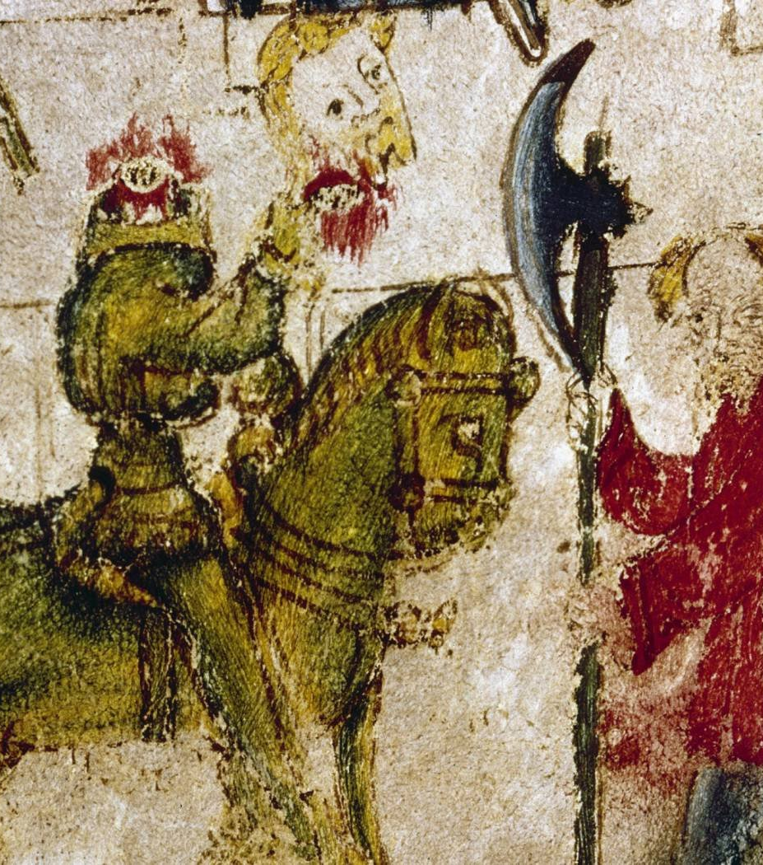
Beheading scene
z
“The Green Knight on the ground now gets himself ready,
leaning a little with the head he lays bare the flesh,
and his locks long and lovely he lifts over his crown,
letting the naked neck as was needed appear.
”
“Gawain gripped on his axe, gathered and raised it,
from aloft let it swiftly land where ’twas naked,
… The fair head to the floor fell from the shoulders,
and folk fended it with their feet as forth it went rolling;
the blood burst from the body, bright on the greenness,
and yet neither faltered nor fell the fierce man at all,
but stoutly he strode forth, still strong on his shanks,
and roughly he reached out among the rows that stood there,
caught up his comely head and quickly upraised it,
and then hastened to his horse, laid hold of the bridle,
stepped into stirrup-iron, and strode up aloft,
his head by the hair in his hand holding;
and he settled himself then in the saddle as firmly
as if unharmed by mishap, though in the hall he might
wear no head.

Slide 23
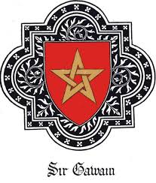
Pentangle: An Endless Knot
“or it is a figure that in it five points holdeth,
and each line overlaps and is linked with another,
and every way it is endless; and the English, I hear,
everywhere name it the Endless Knot.
So it suits well this knight and his unsullied arms;
for ever faithful in five points, and five times under each,
Gawain as good was acknowledged and as gold refinéd,
devoid of every vice and with virtues adorned.”

Slide 24
“First faultless was he found in his five senses,
and next in his five fingers he failed at no time,
and firmly on the Five Wounds all his faith was set
that Christ received on the cross, as the Creed tells us;
and wherever the brave man into battle was come,
on this beyond all things was his earnest thought:
that ever from the Five Joys all his valour he gained
that to Heaven’s courteous Queen once came from her Child.
For which cause the knight had in comely wise
on the inner side of his shield her image depainted,
that when he cast his eyes thither his courage never failed.
The fifth five that was used, as I find, by this knight
was free-giving and friendliness first before all,
and chastity and chivalry ever changeless and straight,
and piety surpassing all points: these perfect five
were hasped upon him harder than on any man else.
Now these five series, in sooth, were fastened on this knight,
and each was knit with another and had no ending,
but were fixed at five points that failed not at all,
coincided in no line nor sundered either,”

Slide 25
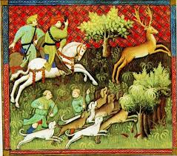
HUNTING SCENES
z

Slide 26
Exchange of Winnings
STAG --------------------) One Kiss
BOAR-----------------------) Two Kisses
FOX-------------------------)three kisses

Slide 27
TEMPTATION
Lady Bertilak: It was the lady herself, most lovely to see,
that cautiously closed the door quietly behind her,
and drew near to his bed. Then abashed was the knight,
and lay down swiftly to look as if he slept;
and she stepped silently and stole to his bed,
cast back the curtain, and crept then within,
and sat her down softly on the side of the bed,
and there lingered very long to look for his waking.”

Slide 28
“A rich ring she offered him of red gold fashioned,
with a stone like a star standing up clear
that bore brilliant beams as bright as the sun:
I warrant you it was worth wealth beyond measure.
But the knight said nay to it, and announced then at once:
‘I will have no gifts, fore God, of your grace at this time.
I have none to return you, and naught will I take.”
“For whoever goes girdled with this green riband,
while he keeps it well clasped closely about him,
there is none so hardy under heaven that to hew him were able;
for he could not be killed by any cunning of hand.”

Slide 29
confession
“He laid up the love-lace that the lady had given,
hiding it heedfully where he after might find it.
Then first of all he chose to fare to the chapel,
privately approached a priest, and prayed that he there
would uplift his life, that he might learn better
how his soul should be saved, when he was sent from the world.
There he cleanly confessed him and declared his misdeeds,
both the more and the less, and for mercy he begged,
to absolve him of them all he besought the good man;”

Slide 30
Repaying scene
p.99-102

Slide 31
The end
“Lo! Lord,’ he said at last, and the lace handled,
‘This is the band! For this a rebuke I bear in my neck!
This is the grief and disgrace I have got for myself
from the covetousness and cowardice that o’ercame me there!
This is the token of the troth-breach that I am detected in,
and needs must I wear it while in the world I remain;
for a man may cover his blemish, but unbind it he cannot,
for where once ’tis applied, thence part will it never.’
The king comforted the knight, and all the Court also
laughed loudly thereat, and this law made in mirth
the lords and the ladies that whoso belonged to the Table,
every knight of the Brotherhood, a baldric should have,
a band of bright green obliquely about him,
and this for love of that knight as a livery should wear.
For that was reckoned the distinction of the Round Table,
and honour was his that had it evermore after,
as it is written in the best of the books of romance.
Thus in Arthur his days happened this marvel,
as the Book of the Brut beareth us witness;
since Brutus[…]”

Slide 32
References
Chism, Christine. «Romance» Larry Scanlon eds. The Cambridge Companion to Medieval English Literature, 1150-1500. Cambridge: Cambridge University Press, 2009. Print
Krueger, Roberta L. The Cambridge Companion to Medieval Romance. Cambridge [u.a.: Cambridge Univ. Press, 2000. Print.
Abrahams, M. H. A Glossary of Literary Terms. Massachuessets: Heinle and Heinle, 1999. Print.
Anonymous. Sir Gawain and the Green Knight. In Green Blatt, Stephen eds. Norton Anthology of English Literature 8th ed: The Major Authors. New York: W. W. Norton, 2006. Print.
Ker, W. P. Medieval English Literature. London: Oxford University Press, 1969. Print.
Bennet, J. A. W. Middle English Literature. Oxford: Clarendon Press, 1986. Print.

